Slide 1
Module 8
Measuring Market Opportunities: Forecasting and Market Research
By: Dr Shahinaz Abdellatif

Slide 2
Objectives of the Session
1. To understand evidence-based forecasting techniques
2. To define the nature of marketing research (MR)
3. To show types of research methodology available for MR
4. To indicate methods of improving MR effectiveness

Slide 3
Steps for Forecasting
Before choosing a method to prepare a forecast, one first must know what is to be estimated or forecasted. First, there’s the size of the potential market, that is, the likely demand from all actual and potential buyers of a product or product class. An estimate of market potential often serves as a starting point for preparing a sales forecast. This market is comprised of those consumers who are likely to have both the willingness and ability to buy.
There’s also the size of the currently penetrated market, those who are actually using the product.
the size of the potential and penetrated markets for the market segments is called target market.
They will also need a sales forecast, in which they predict sales revenues
Notes:
4

Slide 4
Keys to Good Forecasting
Make assumptions explicit
  Then debate the assumptions, not the forecast itself
  Collect data to verify or refute the assumptions
Notes:
4

Slide 5
Keys to Good Forecasting
Use multiple methods
  1.Top down: Under the top-down approach, a central person or persons take the responsibility for forecasting and prepare an overall forecast, perhaps using aggregate economic data, current sales trends etc…
  2. Bottom up: common in decentralised firms, each part of the firm prepares its own sales forecast, and the parts are aggregated to create the forecast for the firm as a whole.
Notes:
4

Slide 6
Methods for Forecasting
Statistical methods
Observation
Surveys
Analogy
Judgment
Market tests
Notes:
4

Slide 7
1- Statistical methods:
Statistical methods use past history and various statistical techniques, such as multiple regression or time series analysis, to forecast the future based on an extrapolation of the past.
This method is typically not useful for forecasting sales for a new product or new business as there is no history in their venture on which to base a statistical forecast. However, in established firms, for established products, statistical methods are extremely useful.
Statistical methods have important limitations. Most important of these is that statistical methods generally assume that the future will look very much like the past. Sometimes this is not the case.
Notes:
4

Slide 8
2- Observation
Another method for preparing an evidence-based forecast is to directly observe or gather existing data about what real consumers do in the product-market of interest.
Observation-based forecasting is attractive because it is based on what people actually do. If behavioural or usage data can be found from existing secondary sources – in company files, at the library, or on the Internet – data collection is both faster and cheaper.
For new-to-the-world products, however, observation is typically not possible and secondary data are not available, since the product often does not yet exist, except in concept form.
Notes:
4

Slide 9
3- Surveys
Surveys can be done with different groups of respondents. Consumers, after being shown a statement of the product concept or a prototype or sample of the product, can be asked how likely they are to buy, creating a survey of buyers’ intentions.
Buyers can also be asked about their current buying behaviour: what they currently buy, how often, or how much they use. The salespeople can be asked how much they are likely to sell, completing a survey of salesforce opinion. Experts of various kinds distribution channel, suppliers, and so on – can also be surveyed.
Surveys possess important limitations, however. For one, what people say is not always what people do. Consumer surveys of buyer intention are always heavily discounted to allow for this fact.
Notes:
4

Slide 10
4- Analogy
Under this method, the product is compared with similar products for which historical data are available.
There are limitations. First, the new product is never exactly like that to which the analogy is drawn.
Second, market and competitive conditions may differ considerably from when the analogous product was launched. Such conditions need to be taken into account.
Notes:
4

Slide 11
5- Judgment
Under this method forecasts are made solely on the basis of experienced judgement, or intuition.
Some decision makers are intuitive in their decision processes and cannot always articulate the basis for their judgements.
Notes:
4

Slide 12
6- Market Tests
Used largely for new products, market tests such as experimental test markets may be done under controlled experimental conditions in research laboratories, or in live test markets with real advertising and promotion and distribution in stores.
Use of test markets has declined over the past two decades as they are expensive to conduct because significant quantities of the new product must be produced and marketing activities of various kinds must be paid for.
Notes:
4

Slide 13
Steps involved in conducting marketing research
1. Identify the managerial problem and define research objectives
2. Determine data sources
3. Design research
4. Collect data
5. Analyze data
6. Report results to the decision maker
Notes:
Instructor suggestion: Use an example of an actual research study with which you are familiar, or use one team’s class project to illustrate the steps in action.

Slide 14
Step 1 Identify the Managerial Problem and Define Objectives
If you don’t have clear objectives any road will get you there!

Slide 15
Step 2 Determine Data Sources
Two key questions:
Q1: Primary or secondary data. Which is better?
Q2: Is qualitative or quantitative data needed, or both?
Notes:
Which is better -- primary or secondary data?
If a research objective can be met using secondary data, that’s usually the best course to follow. Why?
It’s usually less costly to simply find existing secondary data than to collect the information as primary data all over again.
Secondary data are typically based on what people actually do, or how they actually behave.
Discuss whether primary or secondary data is best for the example at hand
Ask, “What is qualitative data best for? Quantitative? What are their limitations? Which should be done first?”
Qualitative data may yield deeper insights into consumer behavior than are available from quantitative research.
For this reason, qualitative data is often conducted first and used to guide subsequent quantitative research.
A drawback of qualitative research is that its generally small samples may not fairly represent the larger population.
The benefit of quantitative research lies in its measurement of a population’s attitudes toward or likely response to products or marketing programs.
Because of their larger sample sizes and quantitative metrics, greater confidence can be placed in quantitative studies.

Slide 16
Step 2 Determine Data Sources
Primary data are data collected from individual research subjects using observation, a survey, interviews, or whatever. The data are then gathered and interpreted for the particular research objective at hand.
Secondary data already exists – on the Internet, in government documents, in the business press, in company files, or wherever. Someone has already done the primary data collection and placed the data where others can access it, whether easily or with difficulty, whether free or at some cost.
Notes:
Which is better -- primary or secondary data?
If a research objective can be met using secondary data, that’s usually the best course to follow. Why?
It’s usually less costly to simply find existing secondary data than to collect the information as primary data all over again.
Secondary data are typically based on what people actually do, or how they actually behave.
Discuss whether primary or secondary data is best for the example at hand
Ask, “What is qualitative data best for? Quantitative? What are their limitations? Which should be done first?”
Qualitative data may yield deeper insights into consumer behavior than are available from quantitative research.
For this reason, qualitative data is often conducted first and used to guide subsequent quantitative research.
A drawback of qualitative research is that its generally small samples may not fairly represent the larger population.
The benefit of quantitative research lies in its measurement of a population’s attitudes toward or likely response to products or marketing programs.
Because of their larger sample sizes and quantitative metrics, greater confidence can be placed in quantitative studies.

Slide 17
Data Collection – Secondary Research (Desk)
Government statistics, market reports, trade associations, press coverage, internet, internal sources, etc.
Government - Census data, electoral registers, social trends, Business Monitor, etc.
Market Reports – Mintel, Euromonitor, Financial Times Reports, Retail Business

Slide 18
Step 2 Determine Data Sources
Qualitative research usually involves small samples of subjects and produces information that is not easily quantifiable.
Qualitative data may yield deeper insights into consumer behaviour than are available from quantitative research. For this reason, qualitative research is often conducted first and used to guide subsequent quantitative research.
An important drawback of qualitative research, however, is that its generally small samples may not fairly represent the larger population. Most experienced marketing researchers would say, ‘Never generalise from qualitative research. Always follow up with a quantitative study to test the hunches developed in the qualitative study.’ Such statements presume, however, that adequate research resources.
Notes:
Which is better -- primary or secondary data?
If a research objective can be met using secondary data, that’s usually the best course to follow. Why?
It’s usually less costly to simply find existing secondary data than to collect the information as primary data all over again.
Secondary data are typically based on what people actually do, or how they actually behave.
Discuss whether primary or secondary data is best for the example at hand
Ask, “What is qualitative data best for? Quantitative? What are their limitations? Which should be done first?”
Qualitative data may yield deeper insights into consumer behavior than are available from quantitative research.
For this reason, qualitative data is often conducted first and used to guide subsequent quantitative research.
A drawback of qualitative research is that its generally small samples may not fairly represent the larger population.
The benefit of quantitative research lies in its measurement of a population’s attitudes toward or likely response to products or marketing programs.
Because of their larger sample sizes and quantitative metrics, greater confidence can be placed in quantitative studies.

Slide 19
Step 2 Determine Data Sources
Quantitative research collects data that are amenable to statistical analysis, usually from large enough samples so that inferences may be drawn with some confidence to the population from which the subjects in the sample are drawn.
The principal benefit of quantitative research lies in its measurement of a population’s attitudes toward or likely response to products or marketing programmes.
Because of their larger sample sizes and quantitative metrics, greater confidence can be placed in quantitative studies, when conducted properly, using appropriate sampling procedures and statistical techniques.
Notes:
Which is better -- primary or secondary data?
If a research objective can be met using secondary data, that’s usually the best course to follow. Why?
It’s usually less costly to simply find existing secondary data than to collect the information as primary data all over again.
Secondary data are typically based on what people actually do, or how they actually behave.
Discuss whether primary or secondary data is best for the example at hand
Ask, “What is qualitative data best for? Quantitative? What are their limitations? Which should be done first?”
Qualitative data may yield deeper insights into consumer behavior than are available from quantitative research.
For this reason, qualitative data is often conducted first and used to guide subsequent quantitative research.
A drawback of qualitative research is that its generally small samples may not fairly represent the larger population.
The benefit of quantitative research lies in its measurement of a population’s attitudes toward or likely response to products or marketing programs.
Because of their larger sample sizes and quantitative metrics, greater confidence can be placed in quantitative studies.

Slide 20
Data Collection – Primary Research
Quantitative (street interviews, telephone, internet, postal questionnaire, consumer panels, omnibus surveys, hall test, recording device (TV audience research), etc.)
Qualitative (discussion groups, in-depth interviews, etc.)

Slide 21
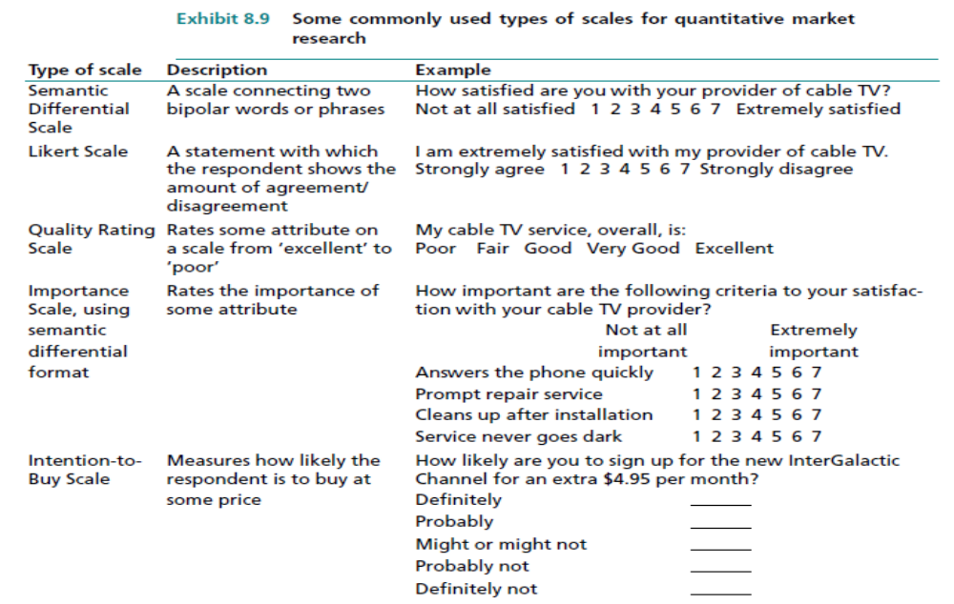
Notes:
Which is better -- primary or secondary data?
If a research objective can be met using secondary data, that’s usually the best course to follow. Why?
It’s usually less costly to simply find existing secondary data than to collect the information as primary data all over again.
Secondary data are typically based on what people actually do, or how they actually behave.
Discuss whether primary or secondary data is best for the example at hand
Ask, “What is qualitative data best for? Quantitative? What are their limitations? Which should be done first?”
Qualitative data may yield deeper insights into consumer behavior than are available from quantitative research.
For this reason, qualitative data is often conducted first and used to guide subsequent quantitative research.
A drawback of qualitative research is that its generally small samples may not fairly represent the larger population.
The benefit of quantitative research lies in its measurement of a population’s attitudes toward or likely response to products or marketing programs.
Because of their larger sample sizes and quantitative metrics, greater confidence can be placed in quantitative studies.

Slide 22
Step 3 Design Primary Research
Three key decisions:
1: Determine data collection method and prepare the research instrument
2: Determine how to contact subjects
3: Design sampling plan

Slide 23
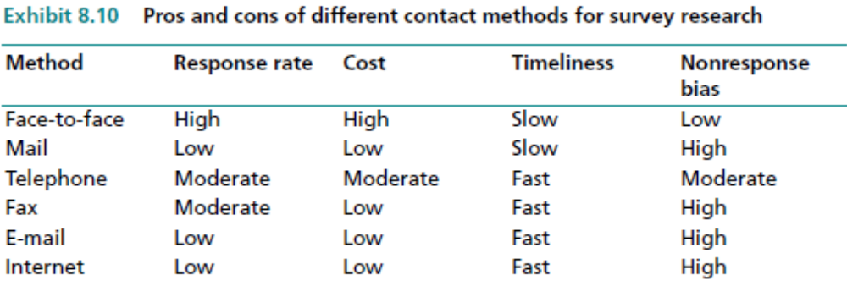
Step 3 Design Primary Research

Slide 24
Steps 4 – 6 Collect, Analyse, and Report the Data
Some Advice:
Beware of collector bias
Know that response rates will be considerably less than 100%
Plan your analysis before you collect the data!

Slide 25
Sampling Plan
Selecting a sample of participants for observational, survey, or experimental research requires that three questions be answered:
• Who is the population (or universe) from which the sample of respondents will be drawn?
• What sample size is required to provide an acceptable level of confidence?
By what method, probability sampling (also called random sampling) or nonprobability
sampling (such as convenience sampling), will the sample be selected?

Slide 26
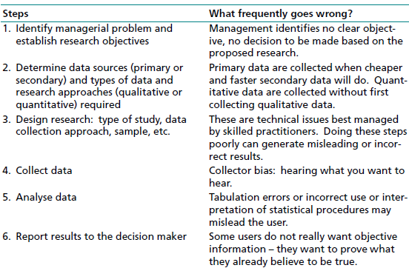
Steps 4 – 6 Collect, Analyse, and Report the Data

Slide 27
What Users of Marketing Research Should Ask
1. What are the objectives of the research? Will the data to be collected meet those objectives?
2. Are the data sources appropriate? Is cheaper, faster secondary data used where possible? Is qualitative research planned to ensure that quantitative research, if any, is on target?
3. Are the planned qualitative and/or quantitative research approaches suited to the objectives of the research? Qualitative research is better for deep insights into consumer behaviour, while quantitative research is better for measurement of a population’s attitudes and likely responses to products or marketing programmes.

Slide 28
What Users of Marketing Research Should Ask
4. Is the research designed well? Will questionnaire scales permit the measurement necessary to meet the research objectives? Are the questions on a survey or in an interview or focus group unbiased? Do the contact method and sampling plan entail any known bias? Is the sample size large enough to meet the research objectives?
5. Are the planned analyses appropriate? They should be specified before the research is conducted.

